Slide 1

Palliative and End-of-Life Care: Connecting care that supports the whole person
Greg Parker MBBCh, FRACGP, FAChPM
Director, Brisbane South Palliative Care Collaborative,
Co-director, PallConsult, Advance Care Planning Australia

Slide 2
Individual’s lifetime risk of death since time began
100
Percentage
risk of dying
50
0
Beginning of time
Today
Timeline

Slide 3
Presentation Overview
Dying
Whole Person
Advance Care Planning (ACP)
Connecting Care
Terminal Care and Care in Death
Bereavement

Slide 4
Dying is complex
Dying and death teaches us much about life
It involves psychological, cultural, existential, spiritual, social and medical elements
People hold deeply personal views about end of life for reasons that are important to them
End-of-life care can also be complex – optimally it is proactive, interdisciplinary and always person-centred.

Slide 5
Thinking about wellbeing, connections and care
Physical
Mental and Emotional
Spiritual
Social

Slide 6
Advance Care Planning
It is the cornerstone of proactive end-of-life care
Advance Care Planning provides an opportunity for people to think, discuss, plan and document their wishes for the care they want to receive in the future, if they lose decision making capacity
If we do not know what a person wants at end of life then we cannot practice person-centred care

Slide 7
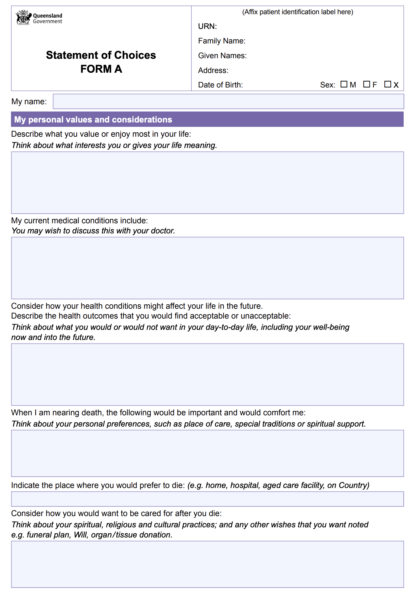

Slide 8
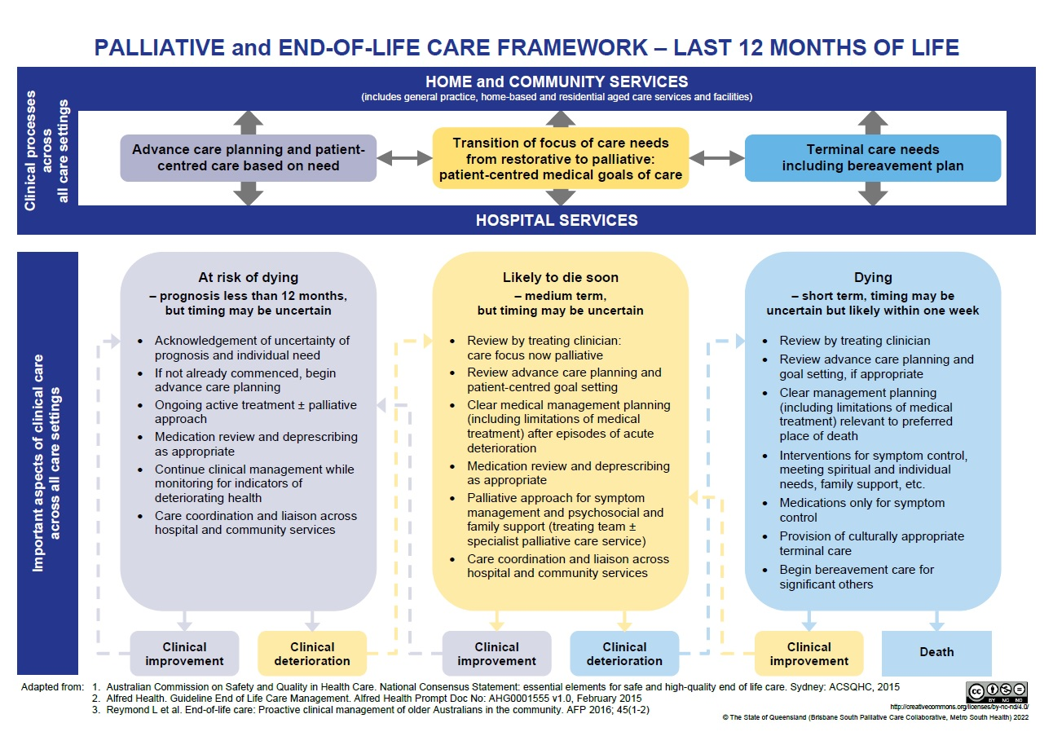

Slide 9
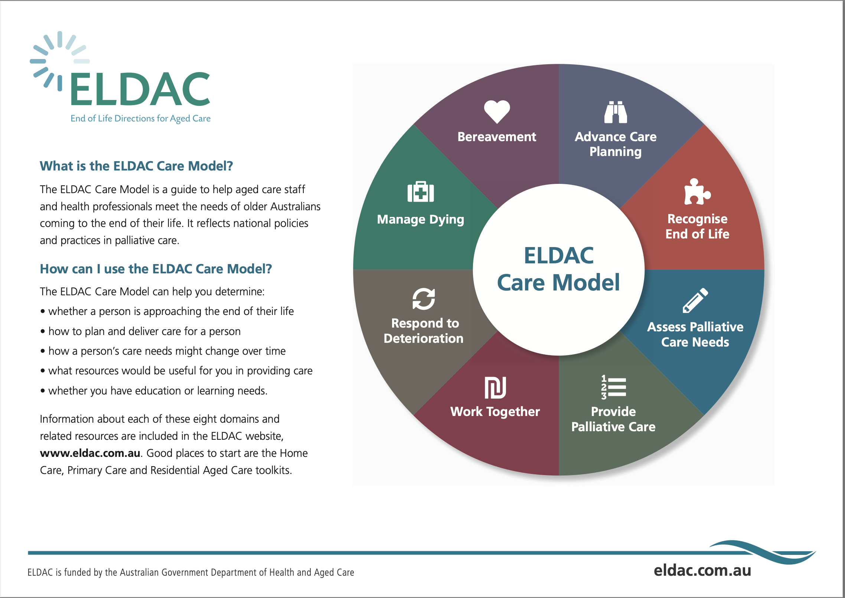

Slide 10
Thinking about wellbeing, connections and care
Physical
Mental and Emotional
Spiritual
Social

Slide 11
Spiritual wellbeing, connections and care
the aspect of humanity that refers to the way individuals seek and express meaning and purpose, and the way they experience their connectedness to the moment, to self, to others, to nature and to the significant or sacred.
Puchalski et al, 2009

Slide 12
UBUNTU
I am Human because you are Human
Community

Slide 13

“ As my body and mind disintegrate,
remember that inside I am
still the person I was when I was
at my peak –and thus I am always
worthy of kindness and respect.”
Christine Longaker
Facing death and Finding Hope

Slide 14

What is hope?
“Perceived capability to produce workable routes to desired goals”#
Hope is not static – it is adaptable (e.g. initially may hope to live to be 110, but this may change to hoping for a high quality life and comfortable death [however defined by the person and family])
There is always something that can be done, and hope can be directed towards doing that successfully.
# Gum and Snyder- Journal of palliative medicine, 2002; 5(6): 883-894)

Slide 15

The work of grieving:
I forgive you
Forgive me
I love you
Thank you
Ira Byock

Slide 16
Questions?

