Slide 1
Dying a good death
How open discussion and ELDAC resources can assist all providers ensure a consultative resident and client centred focus on end-of-life care.
Presented by Naomi Lewis, Clinical Manager Quality & Clinical Excellence

Slide 2

Background
DYING A GOOD DEATH : A CONSULTATIVE FOCUS ON END-OF-LIFE CARE
Villa Maria Catholic Homes (VMCH) is a not-for-profit organisation.
In 2020 we partnered with End of Life Directions for Aged Care (ELDAC) to participate in their Working Together program with the aim to improve palliative care services for residents living in our aged care homes.
At the time, VMCH had a residential aged care portfolio consisting of 12 homes located throughout metropolitan Melbourne and regional Victoria, all of which participated in the program.
Each of our homes provide care for residents from a range of different religious and cultural backgrounds and varying clinical acuity.

Slide 3
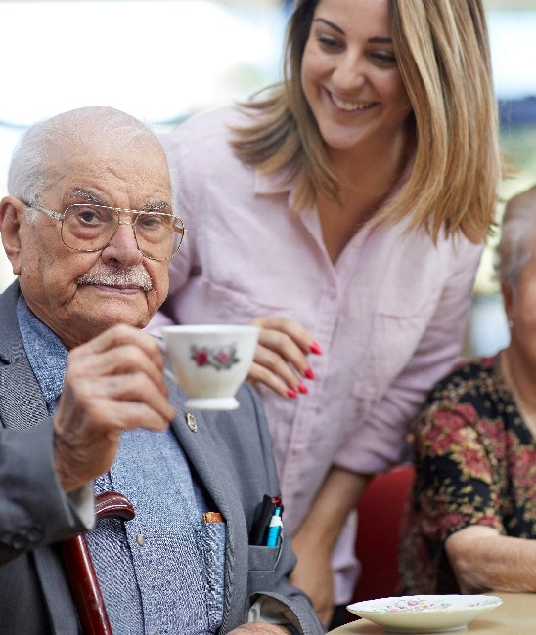

Background
DYING A GOOD DEATH : A CONSULTATIVE FOCUS ON END-OF-LIFE CARE
VMCH’s transformative approach to palliative care
As an organisation, VMCH already had practices underpinned by best practice including:
Multi-disciplinary team approach to palliative care;
Person-centred - our care was tailored to meet individual needs;
Educative role in supporting residents and their families;
Holistic approach to care including cultural, spiritual and religious needs;
Coordinated care and external services as required; and
Communication – promoting collaboration between resident, their family and their care team.

Slide 4




Background
As an organisation, we identified a number of key areas that we wanted to focus our energy on whilst participating in the program to continue to improve and advance our practices:
Advanced Care Planning
Strengthening connections with specialist palliative care services
Upskilling our people
Identifying clinical deterioration

Slide 5


Advanced Care Planning
DYING A GOOD DEATH : A CONSULTATIVE FOCUS ON END-OF-LIFE CARE
Advanced Care Planning
Advance care plan directives are designed to ensure that clinical and end of life care is provided in accordance with the resident’s wishes, values, and beliefs.
Through our experiences, we have learned the importance of ensuring there is consultation between residents and their representatives on what is documented in the advance care plan directive. This helps avoid any confusion when decisions need to be made.
At the time of participating in the ELDAC program, approximately 40% of our resident population had an advanced care plan in place.

Slide 6









Advanced Care Planning (cont.)
Advanced Care Planning
In an effort to improve the percentage of plan in place, VMCH deployed a number of strategies including:
Increasing awareness
Staff education
Review of admission process
Review of clinical handover process
Awareness of medical conditions
Acknowledgement of resident wishes
VMCH has seen a significant increase in the number of advanced care plan directives and/or Medical Goals of Care forms being completed as a result of the work done in this area.

Slide 7
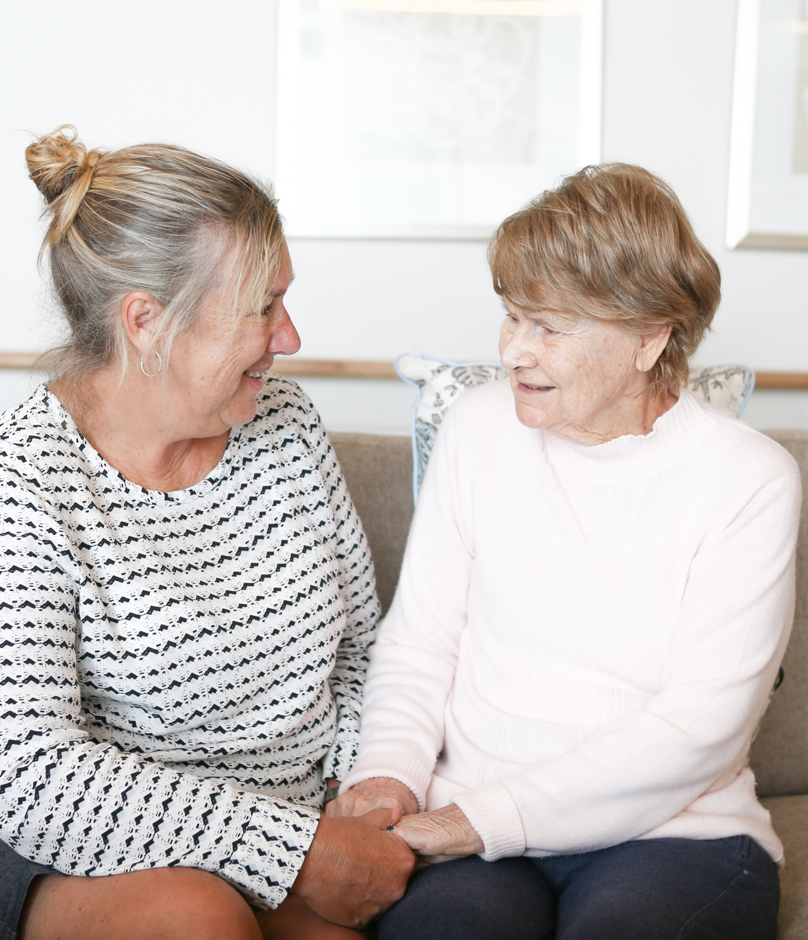
Strengthening Connections
DYING A GOOD DEATH : A CONSULTATIVE FOCUS ON END-OF-LIFE CARE
Strengthening Connections
A priority for VMCH during the ELDAC program was to strengthen the partnerships between the aged care services and specialist palliative care providers.
Identify local palliative care services
Meet with care teams to understand services and referrals
Monthly clinical palliative care review meetings
Our experience was that some palliative care providers were engaging from the beginning, whilst the relationship with others evolved as the program progressed.
VMCH now have strong working relationships with specialist palliative care services and lean on these services for support as needed.
Our staff are more familiar with referral pathways and roles and responsibilities within the services.

Slide 8
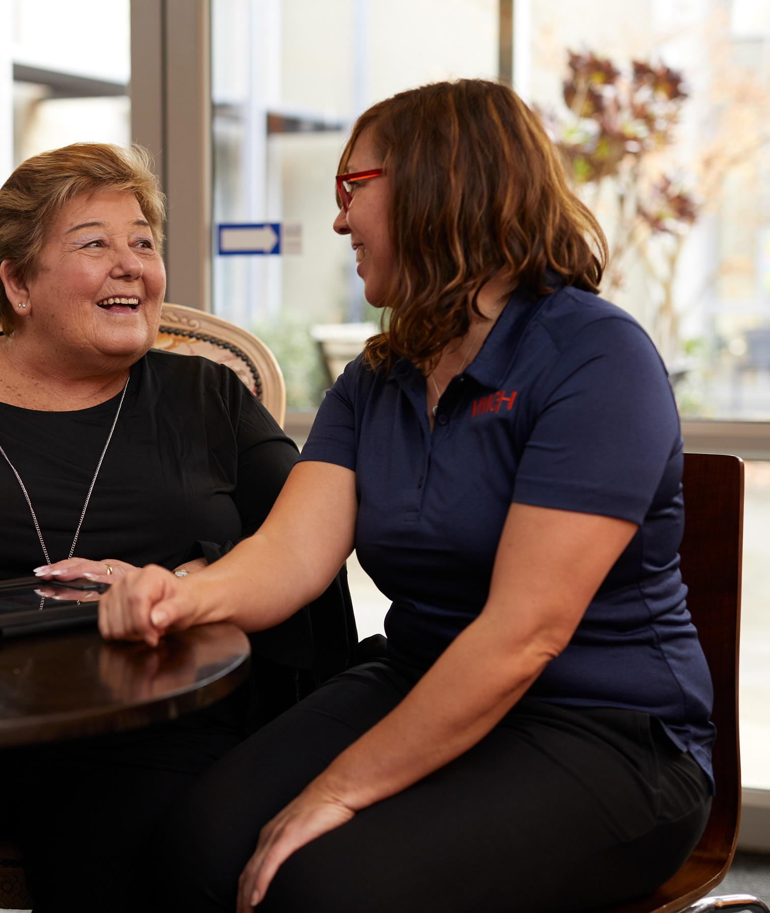
Upskilling Our People
DYING A GOOD DEATH : A CONSULTATIVE FOCUS ON END-OF-LIFE CARE
Upskilling Our People
Ensuring our people had targeted and appropriate training on palliative and end of life care
Extend the training. Training was extended to care staff, allied health, and ancillary staff (not just clinical).
Dedicated resources. A dedicated Palliative Care resource page on the VMCH intranet was developed to house all policies and procedures, and evidence-based practice materials.
Specialised training. In house trainers delivering regular palliative care and pain workshops covering topics such as continuous subcutaneous infusions, symptoms of end of life, pain management and emotional and psychological interventions for residents who are dying.
Professional engagement. VMCH engaged Palliative Care Nurse Practitioner, Regina Kendall, who delivered face-to-face education sessions and facilitated a Reverse PEPA placement for three of the aged care residential services.

Slide 9
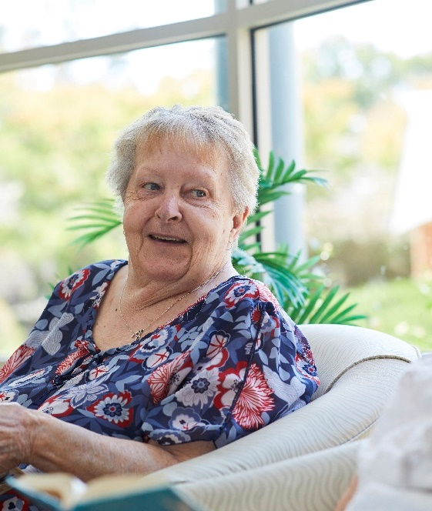
Clinical Deterioration
DYING A GOOD DEATH : A CONSULTATIVE FOCUS ON END-OF-LIFE CARE
Identifying Clinical Deterioration
VMCH identified an area for improvement in managing care of residents who were clinically deteriorating
Experience showed that residents were being transferred to hospital unnecessarily when their care needs could have been managed more effectively in the home, and that there were delays in making appropriate referrals to palliative care services.
Regular reports show a decline in emergency presentations and hospital admissions because of identifying clinical deterioration early and initiating interventions and referrals.
STOP AND WATCH
VMCH developed a tool designed to identify early deterioration in a resident’s clinical condition and to initiate interventions and consultation with relevant people including the treating GP, family, and local hospital in-reach services.
The program was launched across all the aged care services and was supported by staff education and underpinned by relevant organisational policies and procedures.

Slide 10
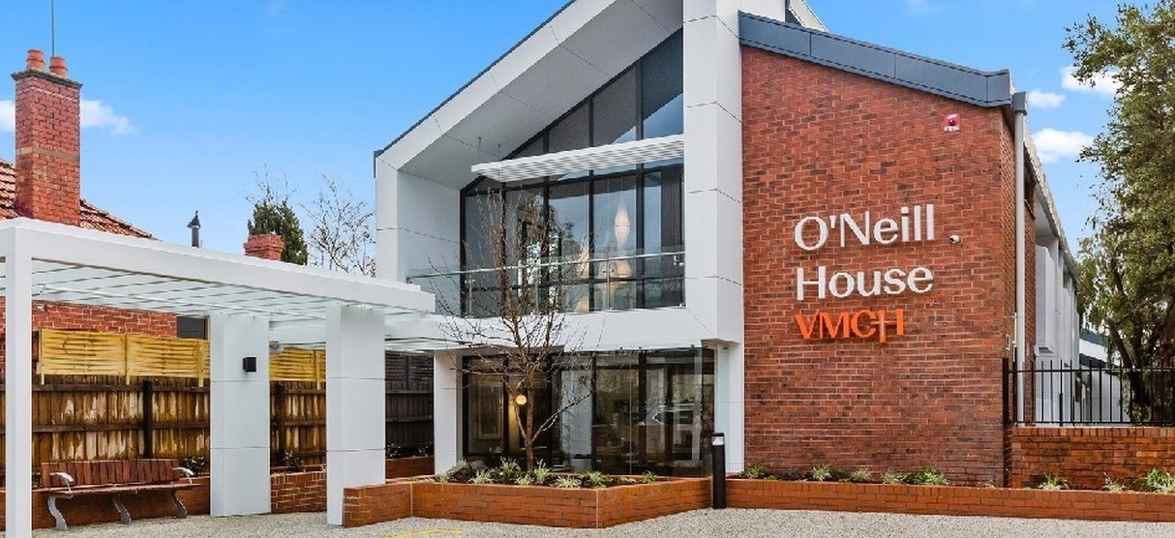
VMCH in 2023
Palliative and end of life care is core business for Villa Maria Catholic Homes and is underpinned by our organisation mission and value statement.
As a Catholic organisation, VMCH is fortunate enough to have a dedicated Pastoral Care Practitioner across all services. The Pastoral Care Practitioner is pivotal in providing emotional and spiritual support to residents, their families, staff, and the wider community.
VMCH is committed to ensuring that residents’ wishes and preferences are respected and that the care delivered is individualised and allows them to have a good death.
Since participating in the ELDAC program, VMCH has expanded the residential aged care portfolio to include a palliative and comfort care facility. O’Neill House in Prahran opened in 2021 and is a 22-bed facility exclusively for residents requiring palliative or end of life care. The home is closely linked with Cabrini Health specialist palliative care services and has a dedicated treating medical practitioner with expertise in palliative care. All staff working at the service have had specific training on palliative care.

Slide 11
DYING A GOOD DEATH : A CONSULTATIVE FOCUS ON END-OF-LIFE CARE
Naomi Lewis
Clinical Manager
Quality and Clinical Excellence
naomi.lewis@vmch.com.au

